Slide 1
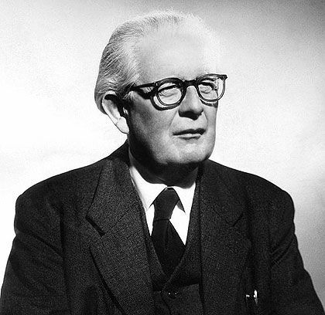
MORAL DEVELOPMENT THEORY – JEAN PIAGET
Morality is not something we are born with fully developed. As we grow, our understanding of right and wrong also grows. A child avoids wrong actions out of fear of punishment. An adult avoids wrong actions because of principles and responsibility. This growth in moral reasoning is called Moral Development.
Jean Piaget was a Swiss psychologist who studied how children develop thinking and reasoning abilities. He explained that moral understanding develops in stages as a child grows and Moral thinking changes with age and maturity.
Piaget said:
Children are not born with full moral understanding.
They gradually learn:
What is right and wrong
Why rules exist
Whether rules can change

Slide 2
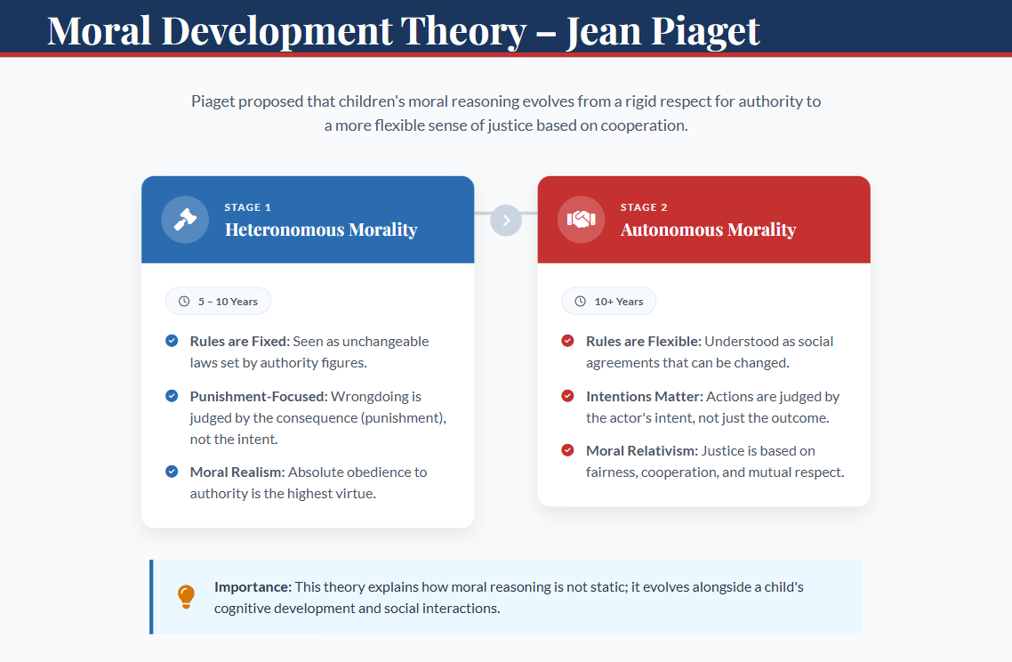

Slide 3
Jean Piaget divided moral development into two main stages:
Stage 1: Heteronomous Morality (Usually seen in children below 10 years)
Children believe:
Rules are fixed and cannot be changed
Rules are made by authority (parents, teachers)
Breaking rules always deserves punishment
Stage 2: Autonomous Morality (Usually after 10 years and continues into adulthood)
Children begin to understand:
Rules are created by people
Rules can be changed by agreement
Intentions matter more than consequences
Characteristics:
Obedience to authority
Fear of punishment
Rigid thinking
No questioning of rules
Characteristics:
Flexible thinking
Understanding fairness
Mutual respect
Considering intentions

Slide 4
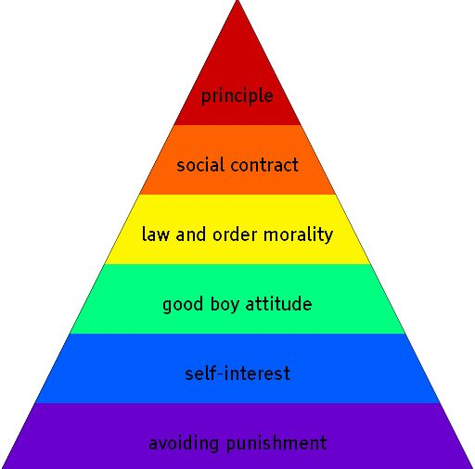
Moral Development Theory: (Lawrence Kohlberg)
Kohlberg explained how people develop moral thinking, that means how we decide what is right and wrong as we grow.
He said moral development happens in 3 levels and 6 stages.
Think of it like climbing steps from selfish thinking to ethical principles.
He proposed that moral reasoning evolves through three distinct levels:
Level I- Pre-Conventional | Level II- Conventional | Level III- Post-Conventional
Obedience & Punishment | Good boy/girl | Social contract
Self-interest | Law & order | Universal principles
Main Idea: Higher level → Higher ethical maturity.

Slide 5
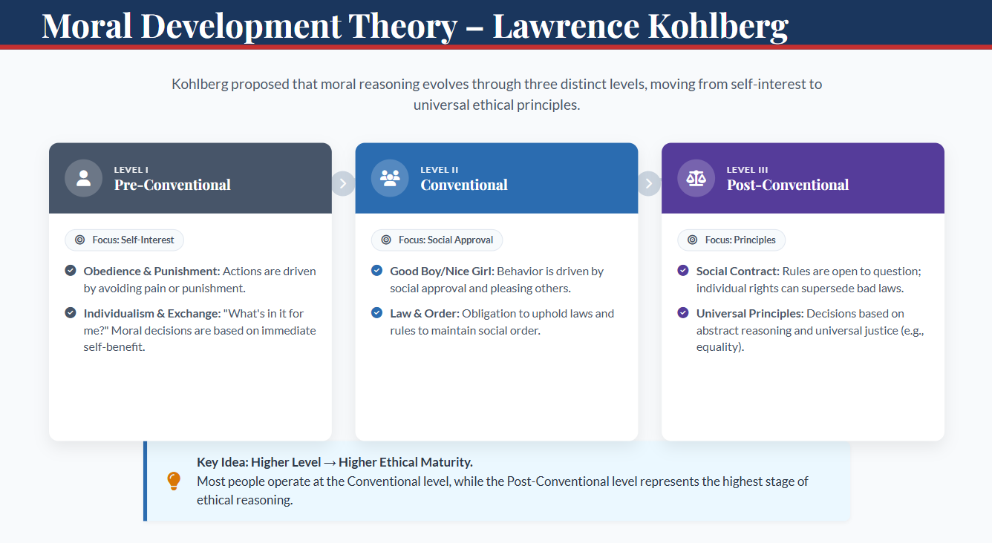

Slide 6
ARISTOTLE’S VIEW ON ETHICS
Core Idea : Purpose of life is happiness (Eudaimonia).
Aristotle believed that ethics is about developing good character. The goal of human life is to achieve happiness (Eudaimonia). But this happiness does not mean pleasure or money. It means living a meaningful life, being a good human being and fulfilling your potential.
What is Virtue?
According to Aristotle: Virtue means good habits that shape good character.
Examples of virtues: Honesty, Courage, Patience, Responsibility, Self-control etc.
He believed:
We are not born virtuous.
We become virtuous through practice.

Slide 7
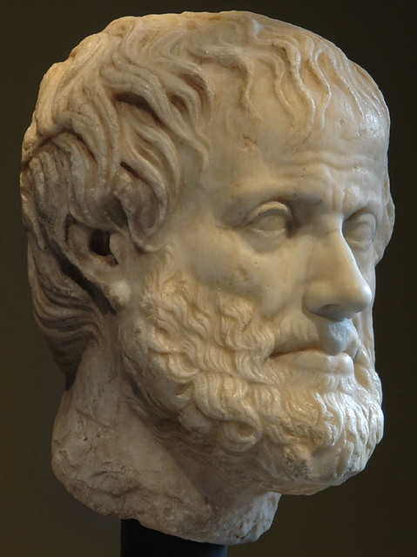
Too Little | Virtue (Middle) | Too Much
Cowardice | Courage | Recklessness
Laziness | Hard work | Workaholism
Silence | Confidence | Arrogance
The Golden Mean
Aristotle said: Virtue lies between two extremes. This is called the Doctrine of the Mean (Golden Mean).
Too much or too little is bad.
Balance is virtue.
Focus on Character, Not Rules
Unlike rule-based ethics, Aristotle focused on: “Who you are” rather than “What rule you follow.”
He believed: Good actions come from good character.

Slide 8
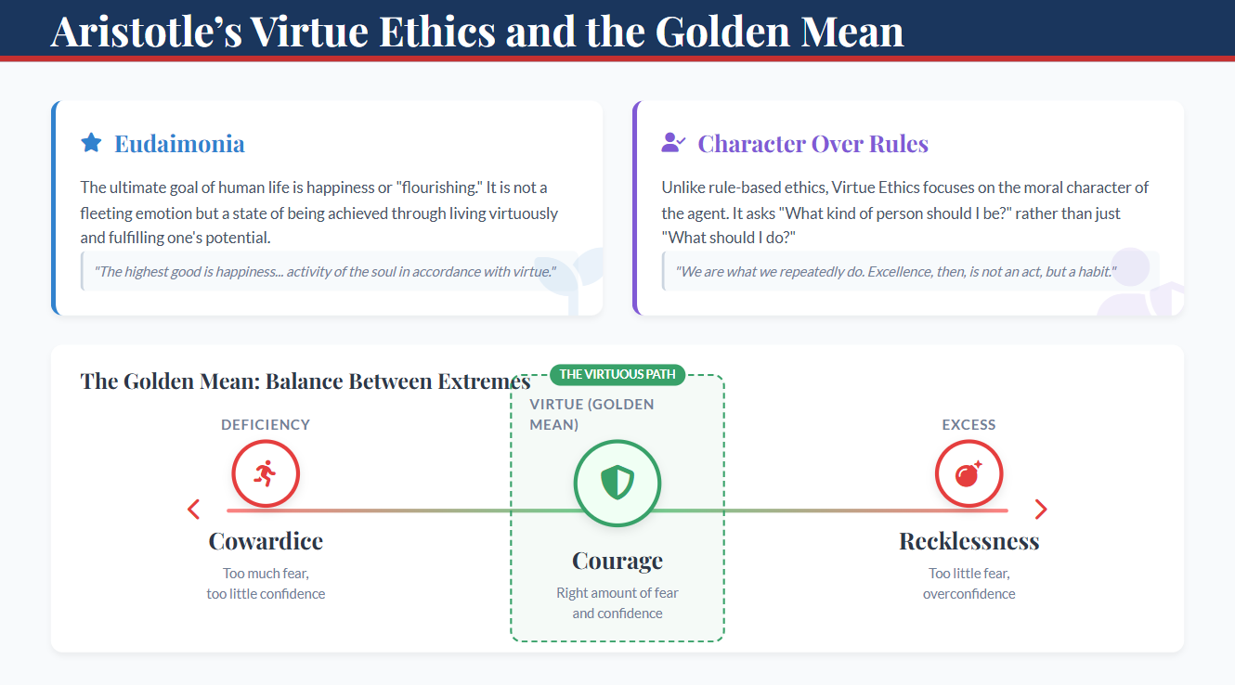

Slide 9
GOVERNING FACTORS OF VALUE SYSTEM
Values shaped by:
Family
Education
Religion
Culture
Media
Peer group
Personal experience
Role: Determines behavior and decisions.

Slide 10
